Slide 1
OBEaaS Outcome Based Education as a Service
Group Members:
Aqib mukhtar se-056
Abdul rehman se-050
Muhammad uzair se-052
Internal supervisor:
Miss asma khan
Industrial advisor:
Dr. Farrukh arif
Software engineering department
Neduet, karachi

Slide 2
Contents
Introduction
Presented in the last evaluation
UML Diagrams
N-Tier Architecture
EERD
Planned VS Achieved
Impact on Project Management
RODbI
Demonstration

Slide 3
Introduction Speaker: Abdul Rehman
OBEaaS provides integrable microservices that aims to digitally transform the OBE system.
It aims to provide a digitalized approach for the process of assigning marks and maintaining the academic records of students on the basis of OBE.
The motivation behind this project is to reduce the efforts the teachers have to make in handling the student’s records manually.
It also aims to provide the students, a platform where they can see their progress report in each semester.

Slide 4
Presented in the last evaluation Speaker: Abdul Rehman
Use Case Diagram
(https://github.com/AqibMukhtar/OBE-as-a-Service/blob/main/Documentation/Diagrams/Rendered/Use%20Case%20Diagram.svg)
Software Architecture (Component Diagram & Context Diagram)
(https://github.com/AqibMukhtar/OBE-as-a-Service/blob/main/Documentation/Diagrams/Rendered/Component%20Diagram.svg)
(https://github.com/AqibMukhtar/OBE-as-a-Service/blob/main/Documentation/Diagrams/Rendered/Context%20Diagram.png)
Database Structure (EERD)
(https://github.com/AqibMukhtar/OBE-as-a-Service/blob/main/Documentation/Diagrams/Rendered/OBE-as-a-Service%20ERD.pdf)
Prototype
(https://github.com/AqibMukhtar/OBE-as-a-Service/blob/main/Documentation/Diagrams/Rendered/Prototype.pdf)

Slide 5
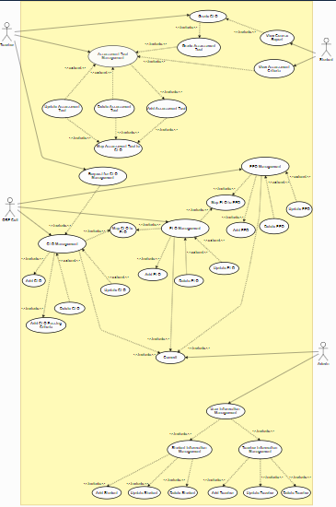
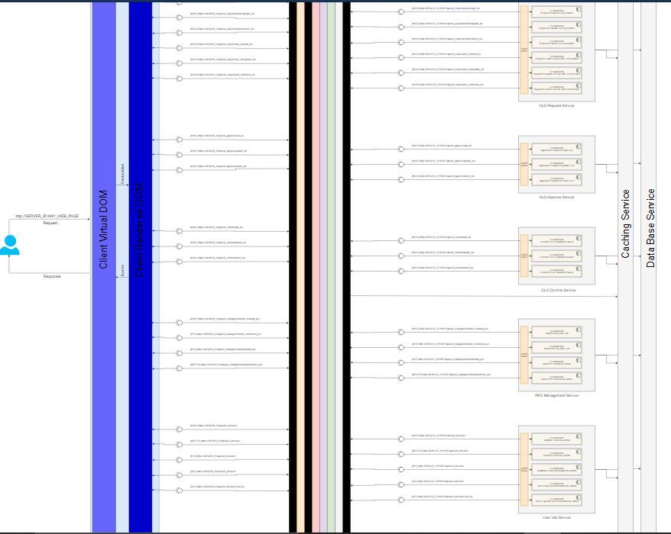
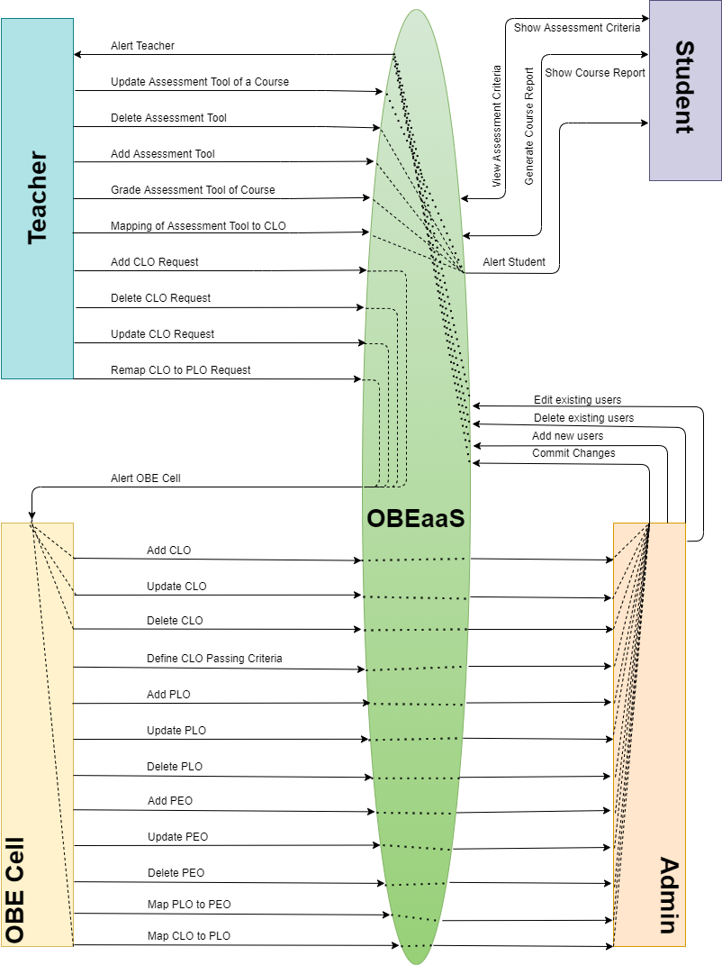
UML Diagrams Speaker: Muhammad Uzair

Slide 6
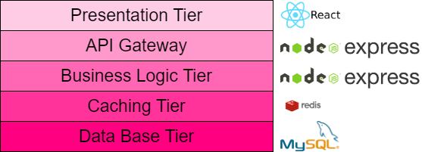
N-Tier Architecture Speaker: Muhammad Uzair
The five layers of our architecture are as follows:
Application Tier
API Gateway
Business Logic Tier
Caching Tier
Database Tier

Slide 7
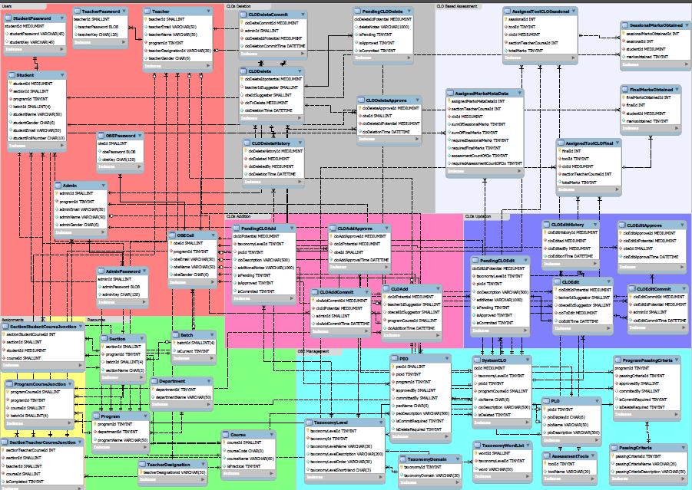
Enhanced Entity Relationship Diagram Speaker: Muhammad Uzair

Slide 8
Planned VS Achieved Speaker: Aqib Mukhtar
According to the Gantt Chart, we had to achieve only a single milestone till the mid year evaluation:
Database procedures
Procedures: 48
Functions: 51
Revisions: 14 times
Estimated completion time: Last week of February
Actual completion time: 2nd week of March

Slide 9
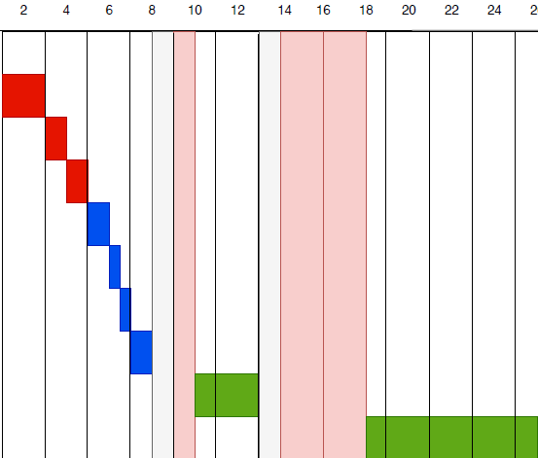
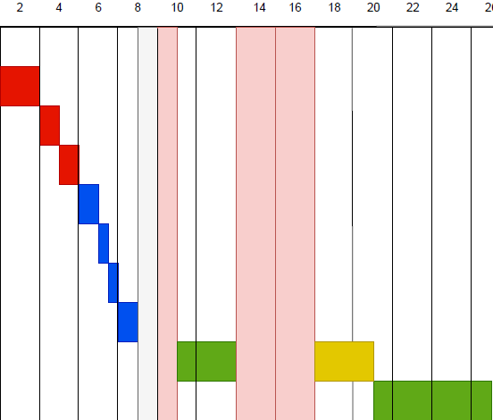
Impact on project management Speaker: Aqib Mukhtar
One milestone (Database Procedures) moved from 13th week to 19th week, due to 4 weeks of early delay by final examination.
The overall effort increased from 4 weeks to 7 weeks.
Project completion time remain same.
Original Gantt Chart
Revised (i) Gantt Chart

Slide 10
Return on Database Investment Speaker: Aqib Mukhtar
Why we invested to much time on database? What returns are expected?
Productivity – Its difficult to work on different paradigms simultaneously
Microservices – Focus on which service to deliver, rather than how to deliver
Security – Validations implemented at bottom most layer will prevent security flaws
Time – Less time to develop new services
Maintainability & Adaptability – Easy to maintain or add new features into the system, without knowing too much about core organizational policies
Major non-functional requirements are the returns of the investment in the database.

Slide 11
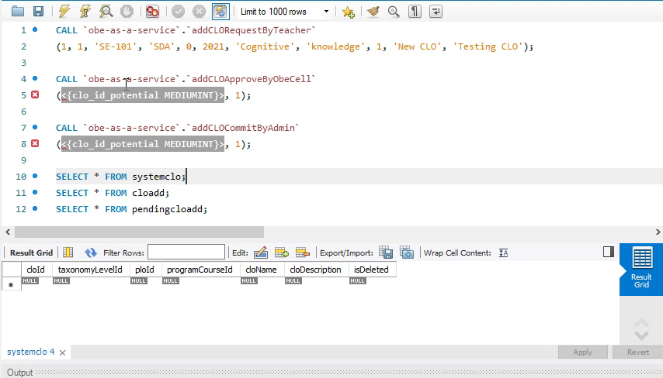
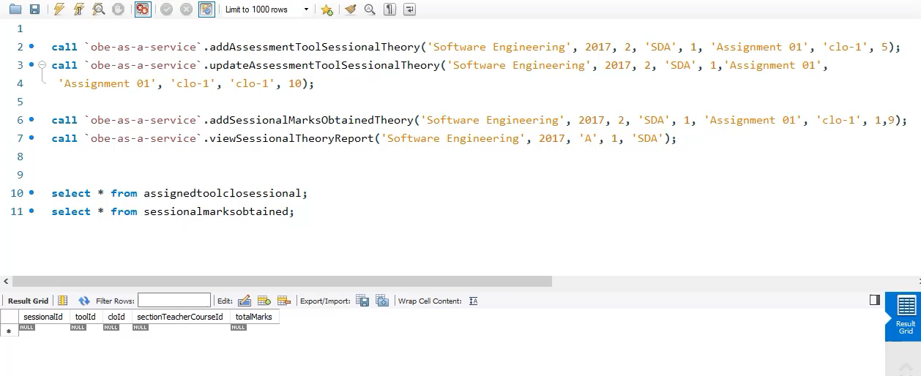
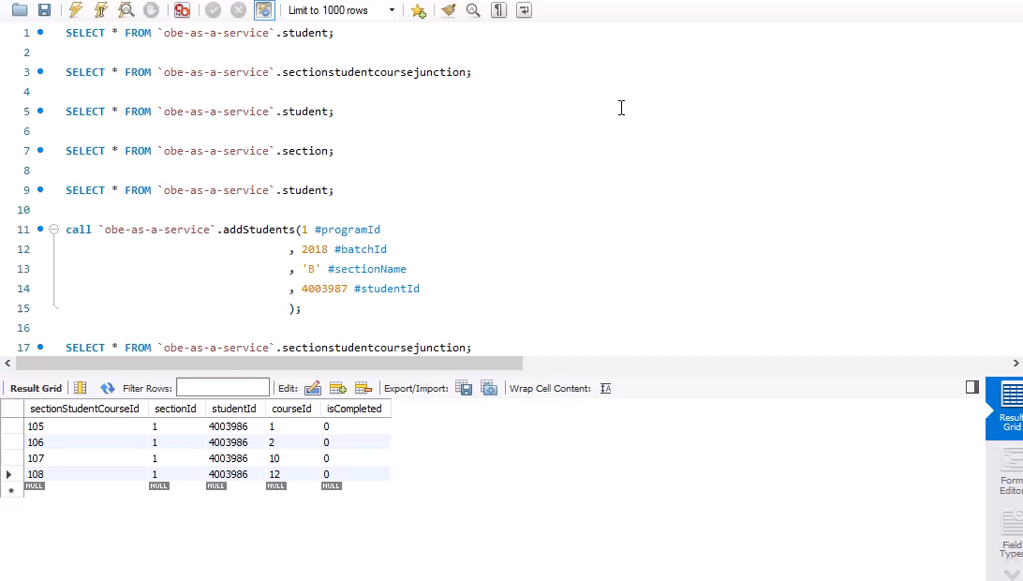
Procedures Demonstration
CLO addition, on
request of teacher
Assessment tool management by teacher
Add students by admin

Slide 12
Question Answer Session

